Slide 1
KLU Design Thinking for Innovation Project Title: PROROUTE
Department : CSE Section : 9 Batch : 3

Slide 2
Project Team - Introduction
S.NO | ID.NO | Name | Role in the project
1 | 2320030344 | M.Manasa
2 | 2320030136 | T.Sai Nysitha
3 | 2320090060 | Manvitha
4 | 2320090066 | E.Kaarteka
5
6
7
8
9
10

Slide 3
PROROUTE (Mapping careers, Empowering Futures)
Mapping careers means creating a plan or a roadmap for your career development . It involves identifying your long-term career goal, the skills and experiences you need to achieve it, and the steps you need to take along the way.

Slide 4
Breakdown of potential careers across different fields:
Science
Biologist: Study living organisms and their environments.
Chemist: Research and analyze substances at the molecular and atomic levels.
Physicist: Investigate the nature of the universe, energy, and matter.
Ecologist: Study the relationships between organisms and their environments.
Arts and Humanities:
Writer/Author: Create written content for various publications.
Graphic Designer: Design visual concepts using computer software.
Historian: Research and analyze historical events, periods, and cultures.
Musician/Composer: Create and perform music compositions.

Slide 5
Social Sciences:
Psychologist: Study behavior and mental processes.
Sociologist: Analyze human societies and social behavior.
Economist: Study the production and distribution of resources.
Political Scientist: Research political systems and behavior.

Slide 6
Business and Management:
Marketing Manager: Develop marketing strategies and campaigns.
Financial Analyst: Analyze financial data and make investment recommendations.
Human Resources Manager: Oversee recruitment, training, and employee relations.
Operations Manager: Manage daily operations and streamline processes.
Technology:
Software Developer/Engineer: Create applications, systems, or software.
Network Administrator: Manage and support an organization's computer networks.
Cybersecurity Analyst: Protect systems and networks from cyber threats.
UX/UI Designer: Design user interfaces and experiences for digital products.

Slide 7
QUESTIONNAIRE
https://docs.google.com/forms/d/e/1FAIpQLSdFJ87QUg-QVBOTyH5lBxKkZ3GXAt2MXp05mFPedJBzniZg2A/viewform

Slide 8
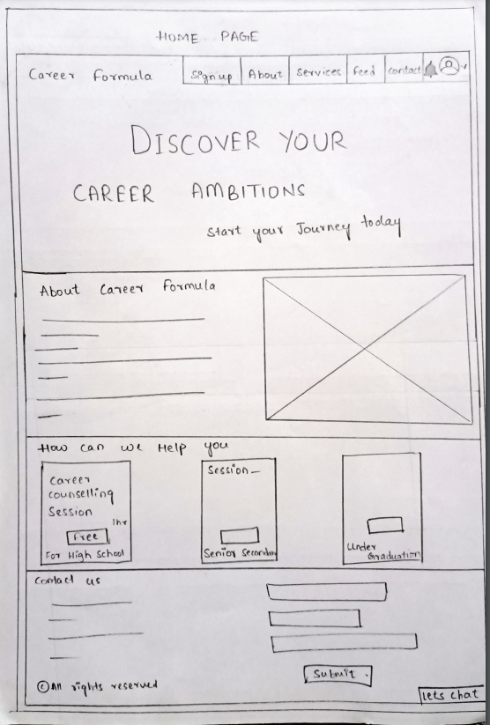
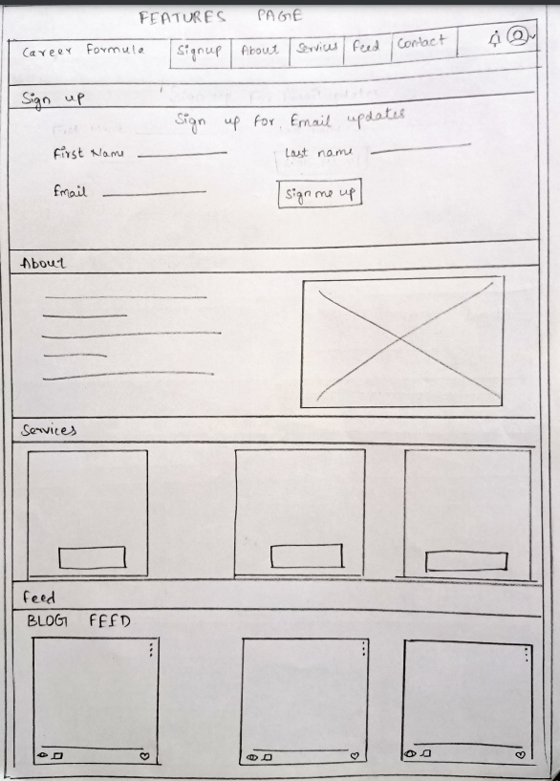
Rough Prototype:

Slide 9
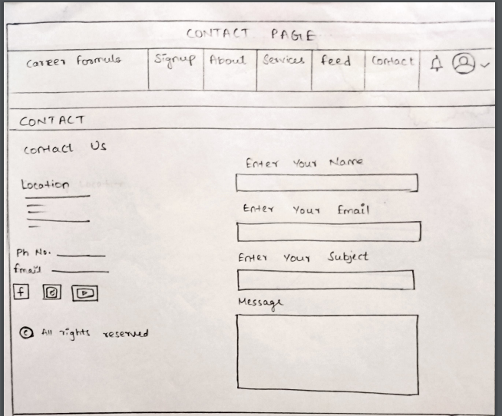
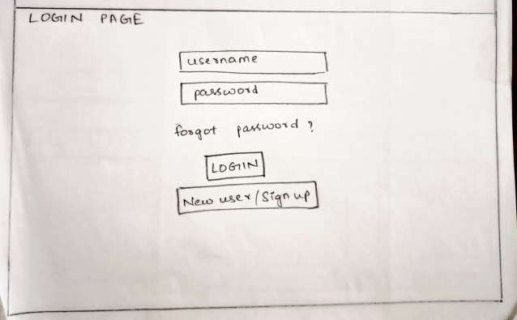
Rough Prototype:

Slide 10
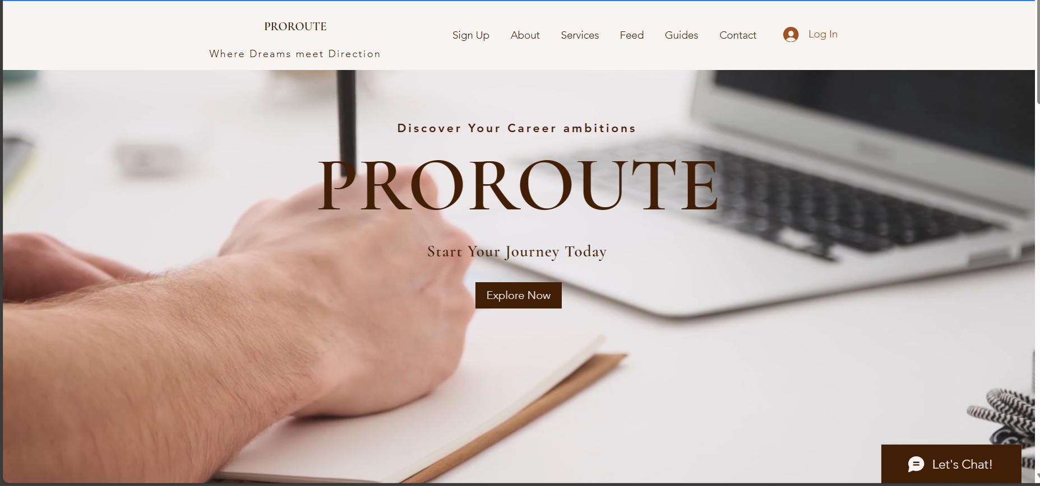
High Fidelity Prototype:

Slide 11
Testing : Submitted Together with this Report
https://github.com/manvitha2005-rgb/ProRoute

Slide 12
THANK YOU

